Slide 1
THIS PAPER PRESENTATION BY
M.SAIRAM
B.TECH.AGRICULTURAL
INDRA GANESAN COLLEGE OF ENGINEERING

Slide 2
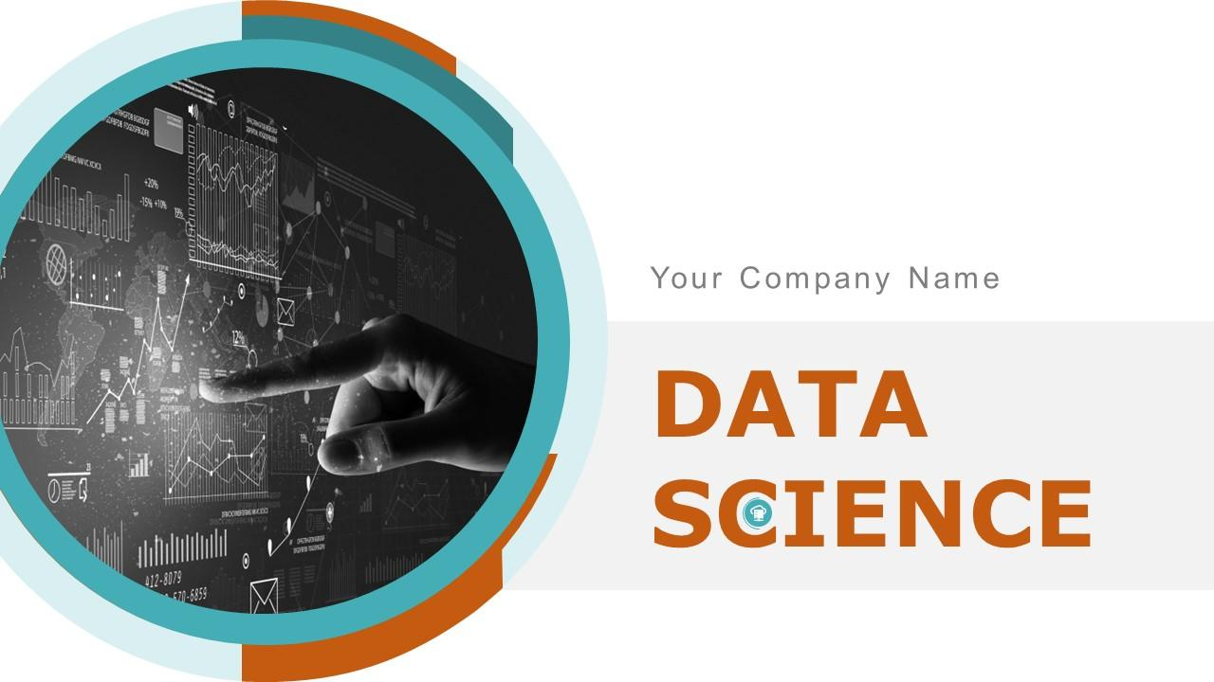

Slide 3
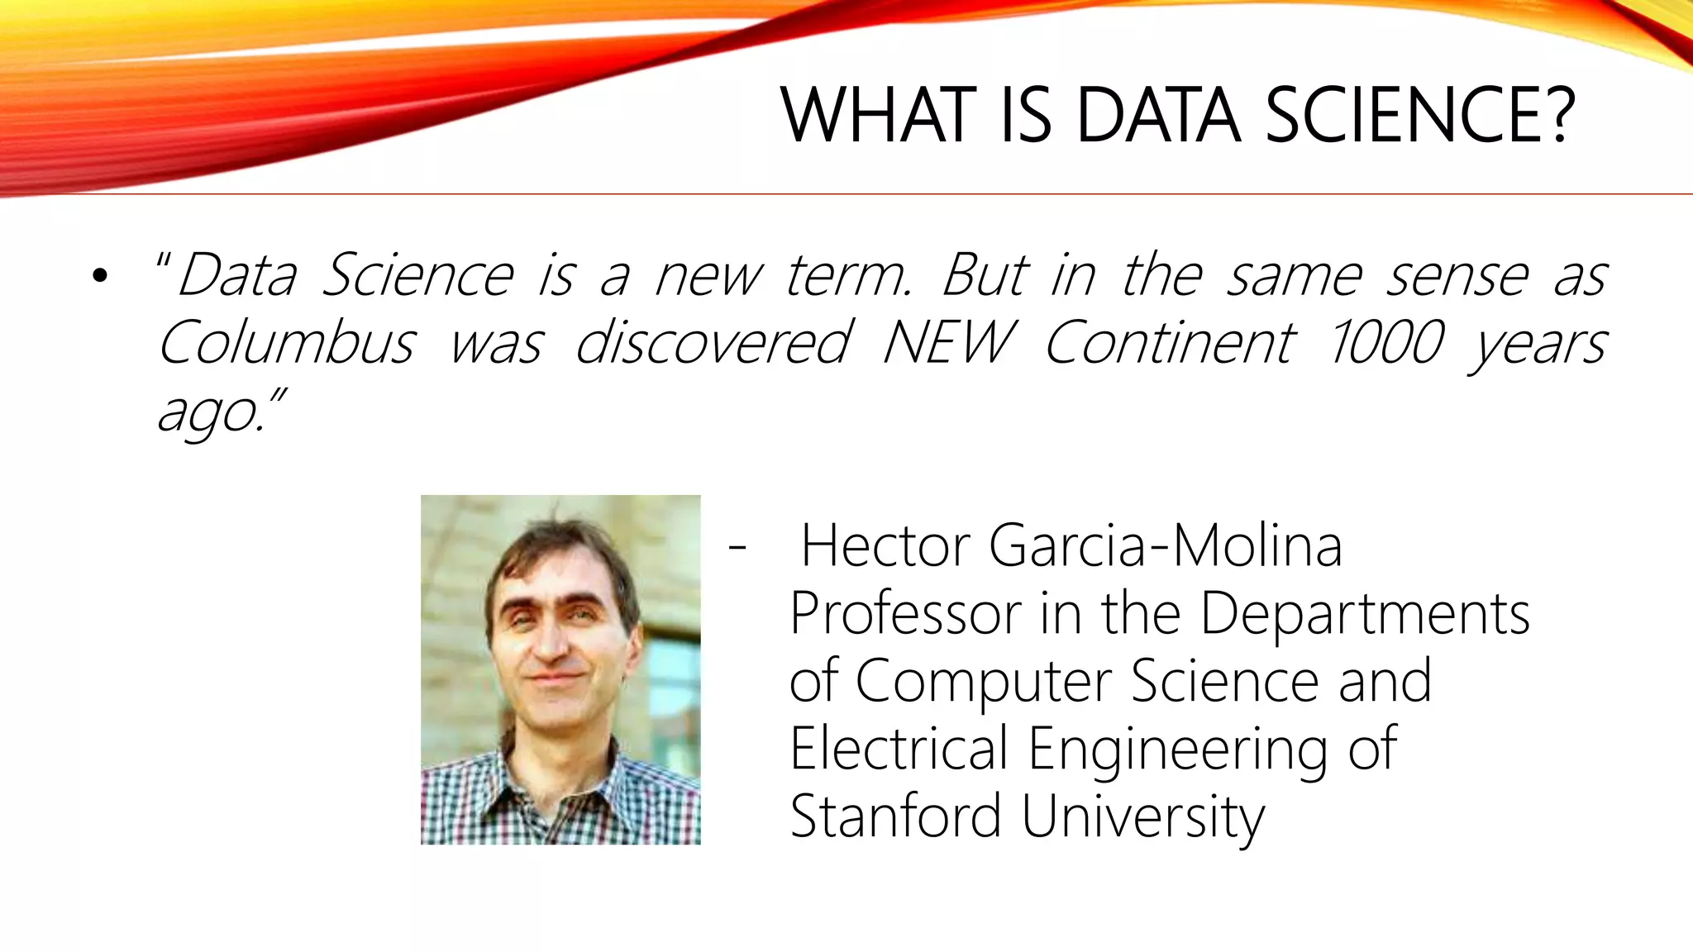

Slide 4
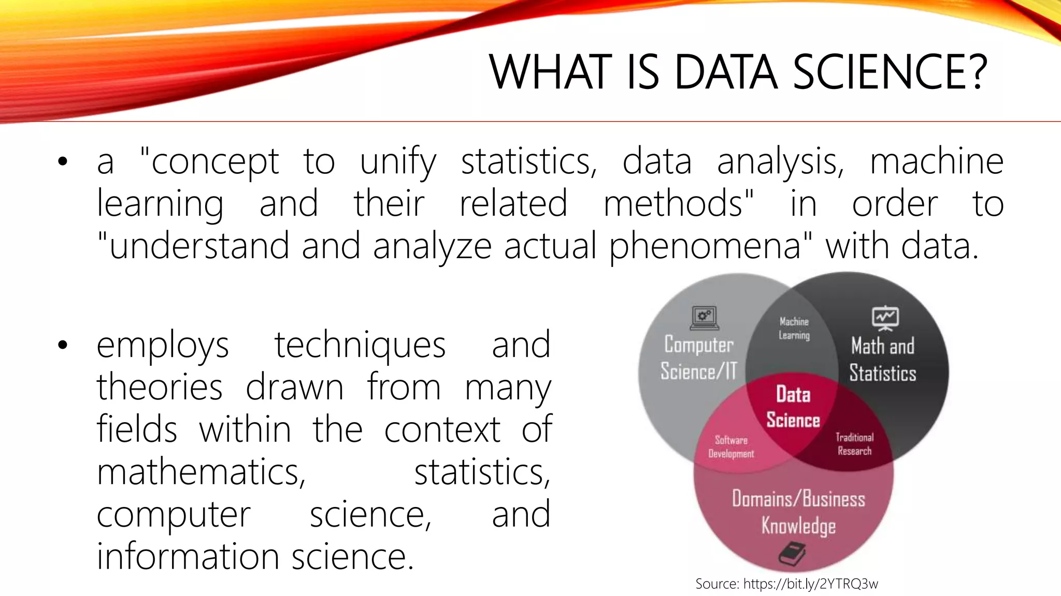

Slide 6
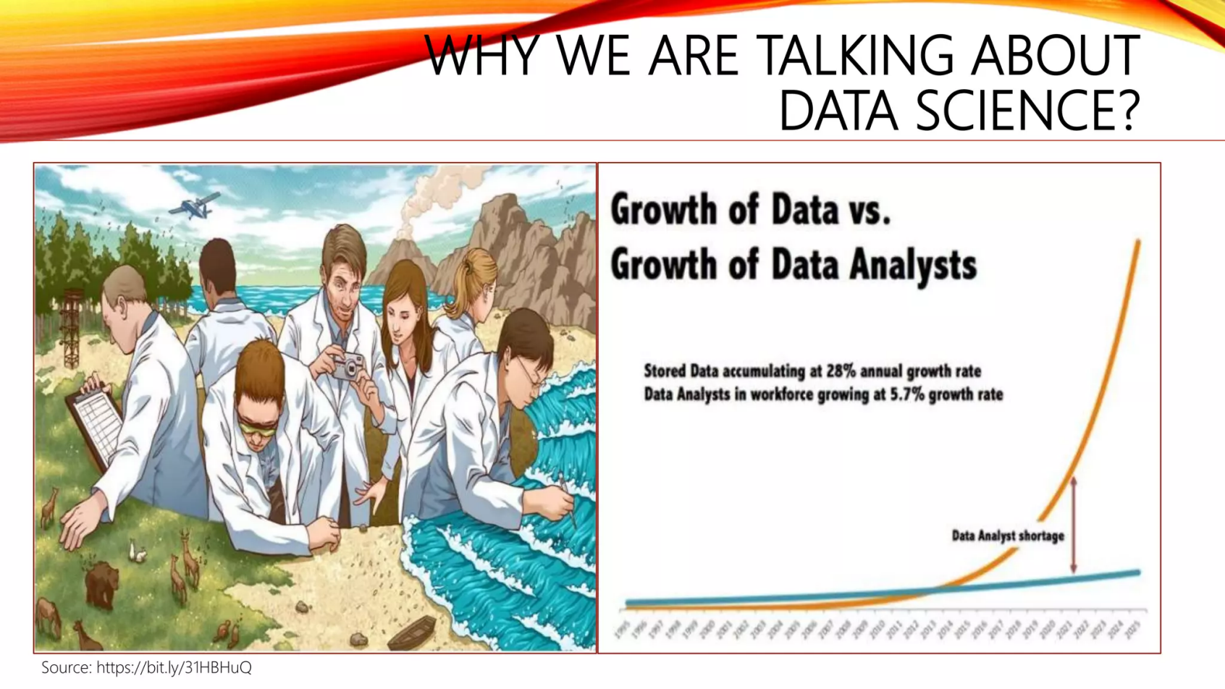

Slide 7
Datascience Funtamentals
Statistics
Machine Learning:
Data Wrangling
Data Visualization
Data Analysis
Big Data Technologies

Slide 8
Statistics
Understanding statistical concepts is crucial in data science. This includes probability distributions, hypothesis testing, regression analysis, and more. Statistics provides the foundation for making inferences and drawing conclusions from data.

Slide 9
Machine Learning
Machine learning is a subset of artificial intelligence that focuses on algorithms and statistical models that enable computers to learn from and make predictions or decisions based on data. This includes supervised learning, unsupervised learning, and reinforcement learning techniques.

Slide 10
Data Wrangling
Data wrangling involves the process of cleaning, transforming, and organizing raw data into a format suitable for analysis. This often involves tasks such as handling missing data, dealing with outliers, and merging data from different sources.

Slide 11
Data Visualization
Data visualization is the graphical representation of data and information. It's an essential part of data science for understanding patterns, trends, and relationships within the data. Tools like matplotlib, seaborn, and ggplot2 are commonly used for creating visualizations.

Slide 12
Data Analysis
Data analysis involves applying statistical techniques and machine learning algorithms to extract insights and knowledge from data. This includes exploratory data analysis (EDA), hypothesis testing, and building predictive models.

Slide 13
Big Data Technologies
With the increasing volume and complexity of data, knowledge of big data technologies such as Hadoop, Spark, and distributed computing frameworks becomes essential for handling large-scale datasets efficiently.

Slide 14


